Slide 1
Privacy in the information age

Slide 2
Learning Outcomes
Discuss the principles, regulations and laws related to privacy both in the GCC and Internationally
5-2

Slide 3
Course Reading
Ethics for the information age
Michael J. Quinn 7th Edition Pearson
5-2

Slide 4
Overview
Introduction
Perspectives on privacy
Information disclosures
Data mining
Examples of consumer backlash
Legal perspective
5-2

Slide 5
Introduction
5-<number>

Slide 6
Information Technology Erodes Privacy
Collection, exchange, combination, and distribution of information easier than ever, lessens privacy
Scott McNealy: “You have zero privacy anyway. Get over it.”
5-4

Slide 7
Information Technology Erodes Privacy
We will consider how we leave an “electronic trail” of information behind us and what others can do with this info
5-4

Slide 8
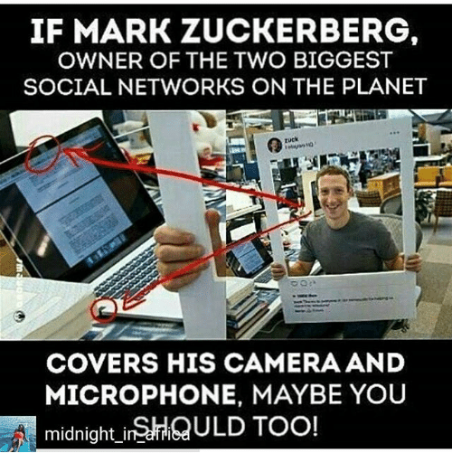
Already too late?
5-<number>

Slide 9
Defining Privacy
Privacy related to notion of access
Access
  Physical proximity to a person
  Knowledge about a person
Privacy is a “zone of inaccessibility”
Privacy violations are an affront to human dignity
Too much individual privacy can harm society
Where to draw the line?
5-6

Slide 10
Privacy and Rights
Privacy
  Moral right of individuals to be left alone, free from surveillance or interference from other individuals or organizations
Information privacy
  Subset of privacy
  Includes both:
    The claim that certain information should not be collected at all
    The claim of individuals to control the use of whatever information is collected about them
5-<number>

Slide 11
Harms of Privacy
Cover for illegal or immoral activities
Burden on the nuclear family
Hidden dysfunctional families
People on society’s fringes can be ignored
5-7

Slide 12
Benefits of Privacy
Individual growth
Individual responsibility
Freedom to be yourself
Intellectual and spiritual growth
Development of loving, trusting, caring, intimate relationships
5-8

Slide 13
Trade offs
In considering privacy it is essential that we recognize the trade offs.
Public good v respecting personal privacy
Enhanced user experiences v loss of privacy in our lives and our homes
5-<number>

Slide 14
Is There a Natural Right to Privacy?
Privacy rights stem from property rights: “a man’s home is his castle”
Samuel Warren and Louis Brandeis: People have “the right to be let alone”
Judith Jarvis Thomson: “Privacy rights” overlap other rights
Conclusion: Privacy is not a natural right, but it is a prudential right
5-9

Slide 15
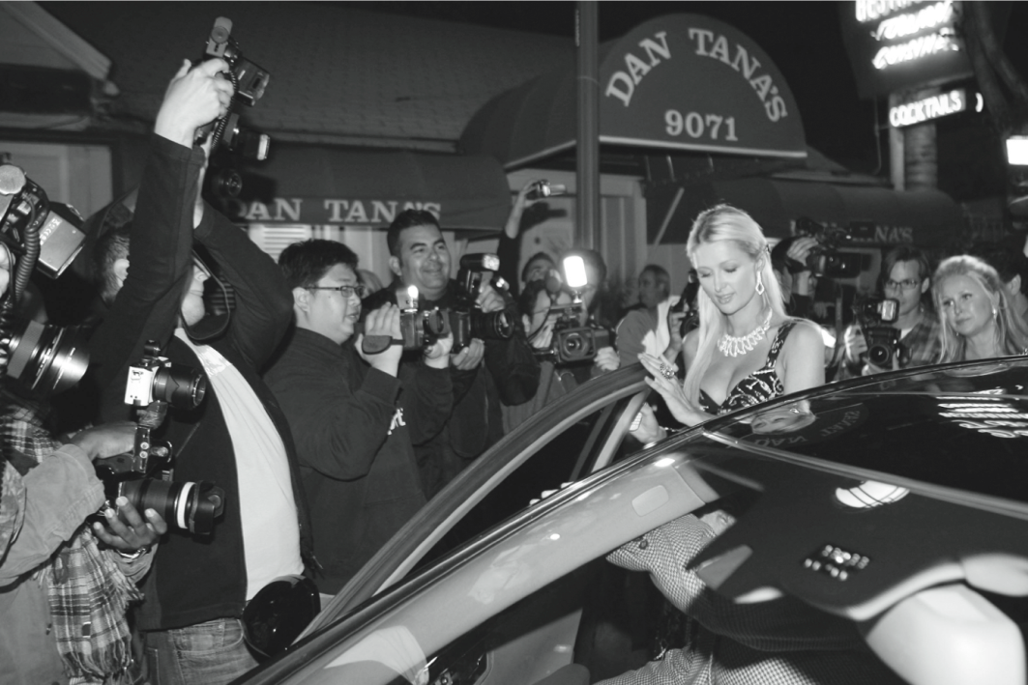
Do People Have the Right to Be Left Alone?
5-<number>

Slide 16
Case Study: New Parents
Sullivans have a baby girl
Both work; they are concerned about performance of full-time nanny
Purchase program that allows monitoring through laptop’s camera placed in family room
They do not inform nanny she is being monitored
5-12

Slide 17
Rule Utilitarian Evaluation
If everyone monitored nannies, it would not remain a secret for long
Consequences
  Nannies would be on best behavior in front of camera
  Might reduce child abuse and parents’ peace of mind
  Would also increase stress and reduce job satisfaction of child care providers
  Might result in higher turnover rate and less experienced pool of nannies, who would provide lower-quality care
Harms appear greater than benefits, so we conclude action was wrong
5-13

Slide 18
Social Contract Theory Evaluation
It is reasonable for society to give people privacy in their own homes
Nanny has a reasonable expectation that her interactions with baby inside home are private
Sullivan’s decision to secretly monitor the nanny is wrong because it violates her privacy
5-14

Slide 19
Kantian Evaluation
Imagine rule, “An employer may secretly monitor the work of an employee who works with vulnerable people”
If universalized, there would be no expectation of privacy by employees, so secret monitoring would be impossible
Proposed rule is self-defeating, so it is wrong for Sullivans to act according to the rule
5-15

Slide 20
Virtue Ethics Evaluation
Sullivans are responsible for well-being of their daughter
Chose nanny through concern for baby: characteristic of good parents
Daughter is truly defenseless, unable to communicate with them
Decision to monitor can be viewed as characteristic of good parents
Would also expect them to cease monitoring once assured nanny is doing well
5-16

Slide 21
Information Disclosures
5-17

Slide 22
Public Records
Public record: information about an incident or action reported to a government agency for purpose of informing the public
Examples: birth certificates, marriage licenses, motor vehicle records, criminal records, deeds to property
Computerized databases and Internet have made public records much easier to access
5-18

Slide 23
Records Held by Private Organizations
Credit card purchases
Purchases made with loyalty cards
Voluntary disclosures
Posts to social network sites
5-19

Slide 24
Data Gathering and Privacy Implications
Facebook tags
Rewards or loyalty programs
Implanted chips
Mobile apps
Medical records
Digital video recorders
Cookies and flash cookies
5-20

Slide 25
Social networks
  Encourage sharing personal details
  Pose unique challenge to maintaining privacy
5-<number>

Slide 26
Facebook Tags
Tag: Label identifying a person in a photo
Facebook allows users to tag people who are on their list of friends
About 100 million tags added per day in Facebook
Facebook uses facial recognition to suggest name of friend appearing in photo
Does this feature increase risk of improper tagging?
5-21

Slide 27
Rewards or Loyalty Programs
Shoppers who belong to store’s rewards program can save money on many of their purchases
Computers use information about buying habits to provide personalized service
  ShopRite computerized shopping carts with pop-up ads
Do card users pay less, or do non-users get overcharged?
5-23

Slide 28
Implanted Chips
Taiwan: Every domesticated dog must have an implanted microchip
  Size of a grain of rice; implanted into ear
  Chip contains name, address of owner
  Allows lost dogs to be returned to owners
RFID tags approved for use in humans
  Can be used to store medical information
  Can be used as a “debit card”
5-28

Slide 29
Mobile Apps
Many apps on Android smartphones and iPhones collect location information and sell it to advertisers and data brokers
  Angry Birds
  Brightest Flashlight
Flurry: a company specializing in analyzing data collected from mobile apps
  Has access to data from > 500,000 apps
5-29

Slide 30
Medical Records
Advantages of changing from paper-based to electronic medical records
Quicker and cheaper for information to be shared among caregivers
  Lower medical costs
  Improve quality of medical care
Once information in a database, more difficult to control how it is disseminated
5-32

Slide 31
Digital Video Recorders
TiVo service allows subscribers to record programs and watch them later
TiVo collects detailed information about viewing habits of its subscribers
Data collected second by second, making it valuable to advertisers and others interested in knowing viewing habits
5-33

Slide 32
Cookies
Cookie: File placed on computer’s hard drive by a Web server
Contains information about visits to a Web site
Allows Web sites to provide personalized services
Put on hard drive without user’s permission
You can set Web browser to alert you to new cookies or to block cookies entirely
5-34

Slide 33
Flash Cookies
Flash cookie: File placed on your computer’s hard drive by a Web server running the Adobe Flash Player
Flash cookie can hold 25 times as much information as a browser cookie
Flash cookies not controlled by browser’s privacy controls
Some Web sites use flash cookies as a way of backing up browser cookies. If you delete browser cookie, it can be “respawned” from the flash cookie
Half of 100 most popular Web sites use flash cookies
5-35

Slide 34
Data Mining
5-<number>

Slide 35
Data Mining Defined
Searching records in one or more databases, looking for patterns or relationships
Can be used to create profiles of individuals
Allows companies to build more personal relationships with customers
5-37

Slide 36
Google’s Personalized Search
Secondary use: Information collected for one purpose use for another purpose
Google keeps track of your search queries and Web pages you have visited
  It uses this information to infer your interests and determine which pages to return
  Example: “bass” could refer to fishing or music
Also used by retailers for direct marketing
5-38

Slide 37
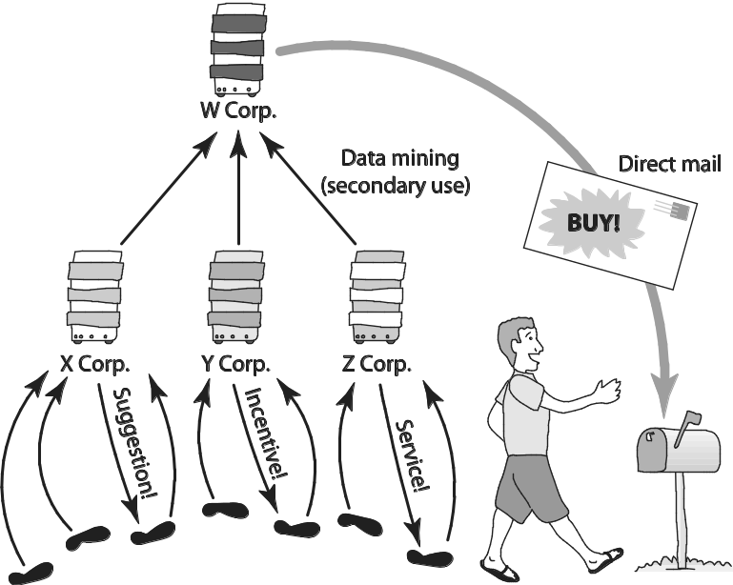
Secondary Uses of Information
5-<number>

Slide 38
Discussion:
Facebook / Cambridge Analytica
How can it condemn the practice on which its business model depends?
https://www.theguardian.com/technology/2018/mar/24/cambridge-analytica-week-that-shattered-facebook-privacy
5-<number>

Slide 39
Ownership of Transaction Information
Who controls transaction information?
  Buyer?
  Seller?
  Both?
Opt-in: Consumer must explicitly give permission before the organization can share info
Opt-out: Organization can share info until consumer explicitly forbid it
Opt-in is a barrier for new businesses, so direct marketing organizations prefer opt-out
5-41

Slide 40
Social Network Analysis
Collect information from social networks to inform decisions
Banks combine social network data with credit reports to determine creditworthiness
5-46

Slide 41
Netflix Prize
Netflix offered $1 million prize to any group that could come up with a significantly better algorithm for predicting user ratings (2006)
Released more than 100 million movie ratings from a half million customers
  Stripped ratings of private information
Researchers demonstrated that ratings not truly anonymous if a little more information from individuals was available
U.S. Federal Trade Commission complaint and lawsuit
Netflix canceled sequel to Netflix Prize (2010)
5-47

Slide 42

5-<number>

Slide 43
Examples of Consumer Backlash
5-<number>

Slide 44
Facebook Beacon
Fandango, eBay, and 42 other online businesses paid Facebook to do “word of mouth” advertising
Facebook users surprised to learn information about their purchases was shared with friends
Beacon was based on an opt-out policy
Beacon strongly criticized by various groups
Facebook switched to an opt-in policy regarding Beacon
5-51

Slide 45
Malls Track Shoppers’ Cell Phones
In 2011 two malls recorded movement of shopper by tracking locations of cell phones
  How much time people spend in each store?
  Do people who shop at X also shop at Y?
  Are there unpopular areas of mall?
Small signs informed shoppers of study
After protest, mall quickly halted study
5-52

Slide 46
iPhone Apps Upload Address Books
In 2012 a programmer discovered Path was uploading iPhone address books without permission
Internet community pointed out this practice violated Apple’s guidelines
CEO of Path apologized; app rewritten
Twitter, Foursquare, and Instagram also implicated for same practice
5-53

Slide 47
Legal Protections
5-<number>

Slide 48
Laws in Bahrain
Bahrain enacted Law No. 30 of 2018 with respect to Personal Data Protection ("PDPL") on July 12, 2018.
The PDPL is the main data protection regulation in Bahrain.
The PDPL came into force on August 1st 2019
5-<number>

Slide 49
Laws in Bahrain
Bahrain enacted several regulations under Information & eGovernment Authority
These include regulations regarding:
  Personal Data Projection
  Digital Identity
  e-procurement
  Access to information
  Telecommunication
  Etc. Find out more here.
5-<number>

Slide 50
Laws in the Gulf region (UAE)
The UAE does not have a comprehensive data protection law at its federal level, however there are a number of laws in place that govern privacy and data security in the UAE.
There are also sector-specific data protection provisions in certain laws.
5-<number>
Notes:
Reference : https://www.dlapiperdataprotection.com/index.html?t=law&c=AE&c2=

Slide 51
Laws in the Gulf region (UAE)
There are several UAE Federal Laws that contain various provisions in relation to privacy and the protection of personal data:
Constitution of the UAE
Penal Code
Cyber Crime Law
Regulating Telecommunications
Dubai: DHCC Health Data Protection Regulation
5-<number>
Notes:
Reference : https://www.dlapiperdataprotection.com/index.html?t=law&c=AE&c2=

Slide 52
United States
Derived from
  Constitution
    First Amendment—guarantees freedom of speech and association
    Fourth Amendment—protects against unreasonable search and seizure
    Fourteenth Amendment—guarantees due process
  Specific statutes and regulations (federal and state)
  Common law
5-53

Slide 53
European Union
The European Directive on Data Protection
European approach:
  Comprehensive and regulatory in nature
European Commission’s Directive on Data Protection:
  Standardizes and broadens privacy protection in European Union countries
5-<number>

Slide 54
European v US approach
Privacy protection much stronger in Europe than the United States
The European approach is very much focused on the user and their rights. The US has a more business centric approach
These different approaches has led to conflicting views. A compromise was found with the safe harbour agreement
5-<number>

Slide 55
Safe Harbour Agreement
EU privacy law forbids the movement of its citizens’ data outside of the EU, unless it is transferred to a location which is deemed to have “adequate” privacy protections in line with those of the EU.
The safe harbour agreement that was made between the EC and the US government essentially promised to protect EU citizens’ data if transferred by American companies to the US.
It allowed companies such as Facebook to self-certify that they would protect EU citizens’ data when transferred and stored within US data centres.
5-<number>

Slide 56
Fast pace of change
It is important to recognize the speed of change in this arena. Governments and law makers are struggling to keep pace with technology.
The pace of change is only likely to increase. So watch this space.
5-<number>

Slide 57
Useful Links
https://www.pwc.com/m1/en/services/tax/legal-services/data-privacy/bahrain-personal-data-protection-law.html
https://www.dlapiperdataprotection.com/index.html?t=law&c=AE&c2=
5-<number>

